Slide 1
OBJECT DETECTION AND ALERT SYSTEM
GROUP 12
CS 5542 : Big Data Analytics and Application
Instructor : Prof. Syed Jawad Shah
Vyoma Desai - 16314631
Tanvi Jain - 16270942
Mohammed Shaik-16319967
Divyanshi Kothari- 12574897

Slide 2
CONTENTS
INTRODUCTION
PURPOSE
DATASET
CURRENT FEATURES
MACHINE LEARNING MODEL
LIVE DEMO

Slide 3
CONTRIBUTION
Vyoma Desai Model, Triangle Similarity, TensorFlow API Training using TensorFlow API Core Idea about the project Distance estimation using Triangle Similarity Demo of the system | Mohammed and Divyanshi Dataset Research Statistics Cleaning and Preprocessing Wider face Dataset | Tanvi Jain Alert System using gTTS Used Annotation using labelling package Efficient Text-To-Speech Conversion System Image scrapped from the web and annotation Used gTTS library Parallelization of Text-To-Speech

Slide 4
INTRODUCTION
Number of visually impaired person in the world is about 285 million.
They suffer regular and constant challenges in Navigation especially when they are on their own and are mostly dependent on someone for even accessing their basic day-to-day needs.
So, it’s a quite challenging task and the technological solution for them is of utmost importance and much needed.

Slide 5
PURPOSE
Most challenging part is the accurate distance estimation of people and object around the person which is our key unique feature.
Our methodology and idea allows blind victims to identify Person and also generate voice response/feedback and calculates distance which produces warnings whether he/she is very close or far away from the person.
Aim of this project is to develop an efficient and a low cost system to help visually impaired to navigate with greater comfort, speed and confidence.

Slide 6
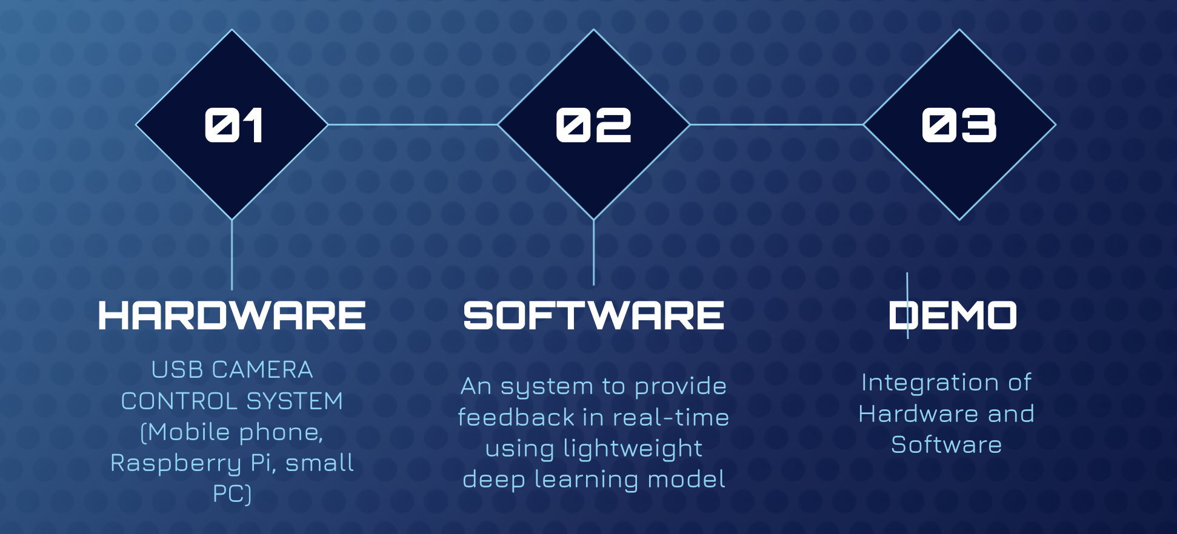
PROJECT OVERVIEW

Slide 7
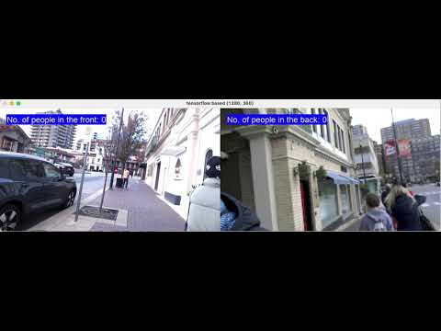
LIVE DEMO
VYOMA DESAI

Slide 8
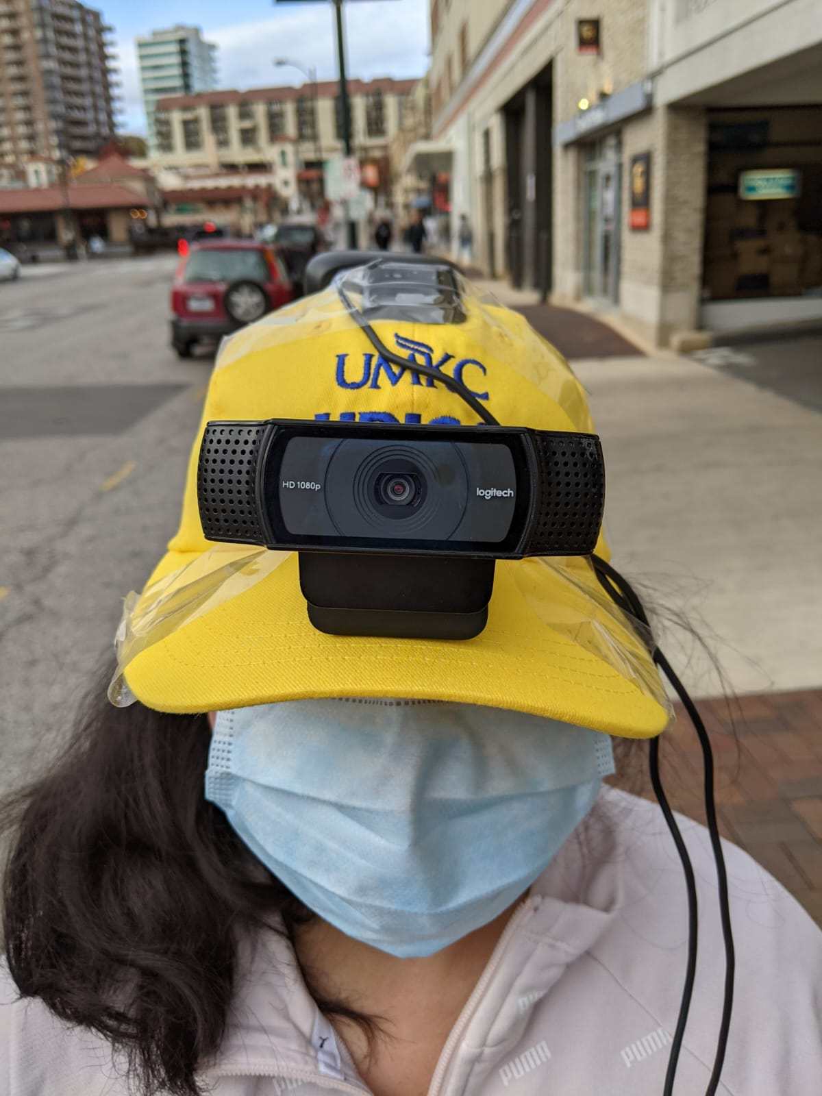
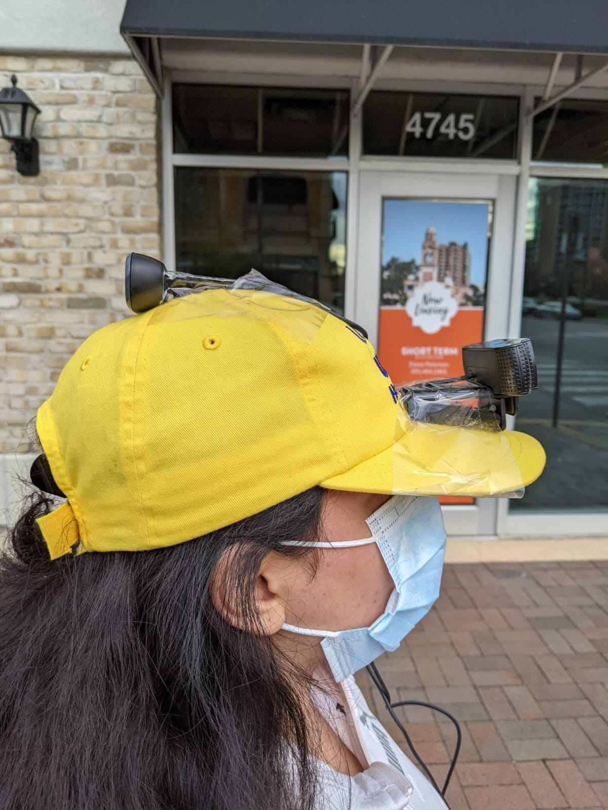
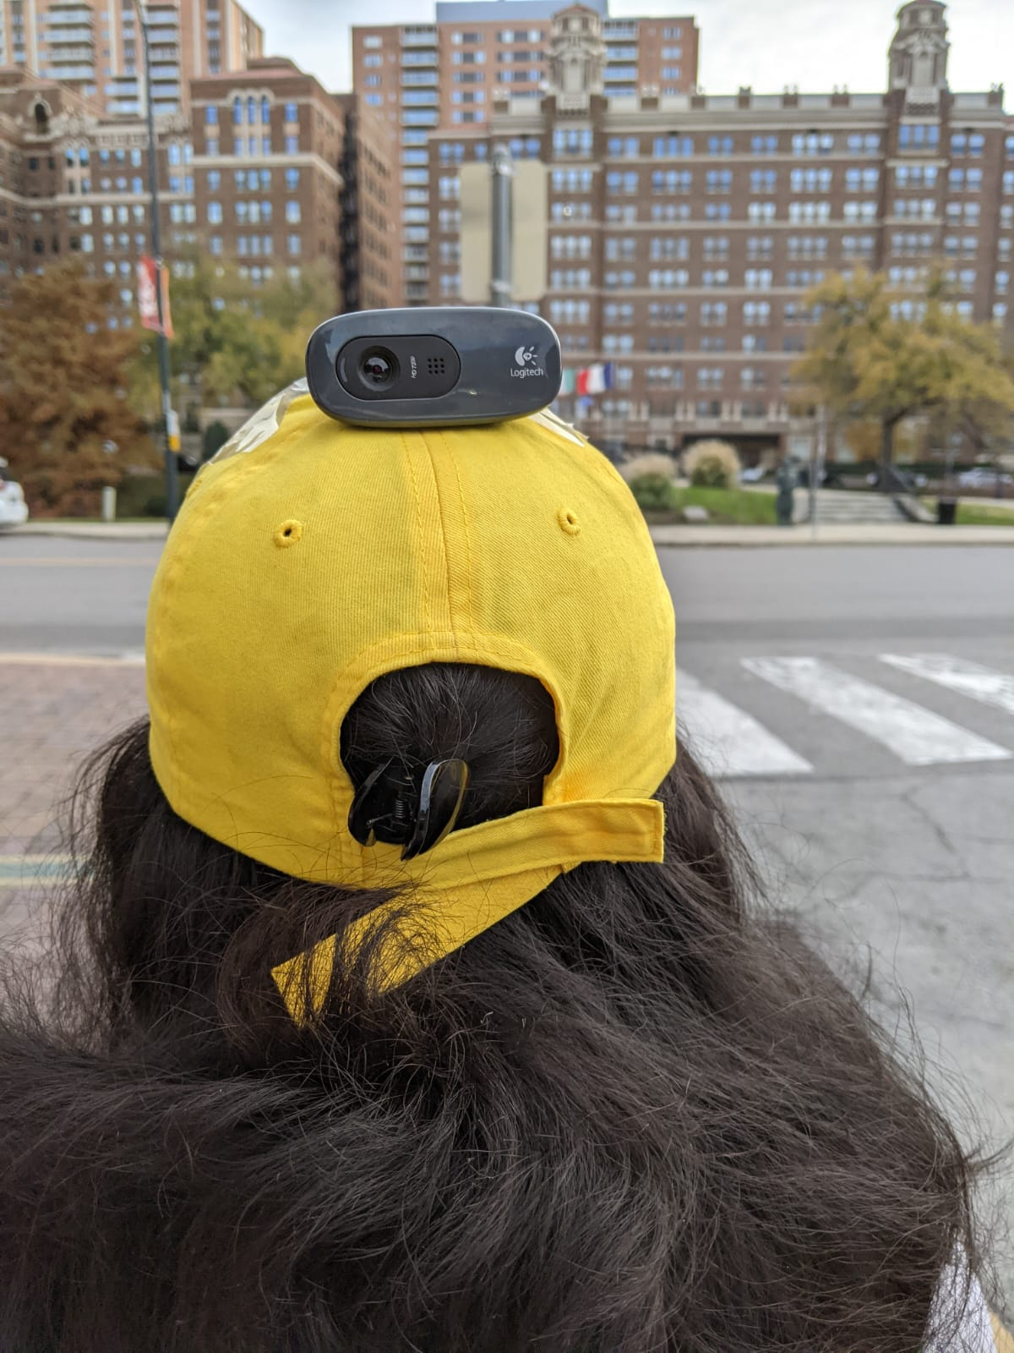
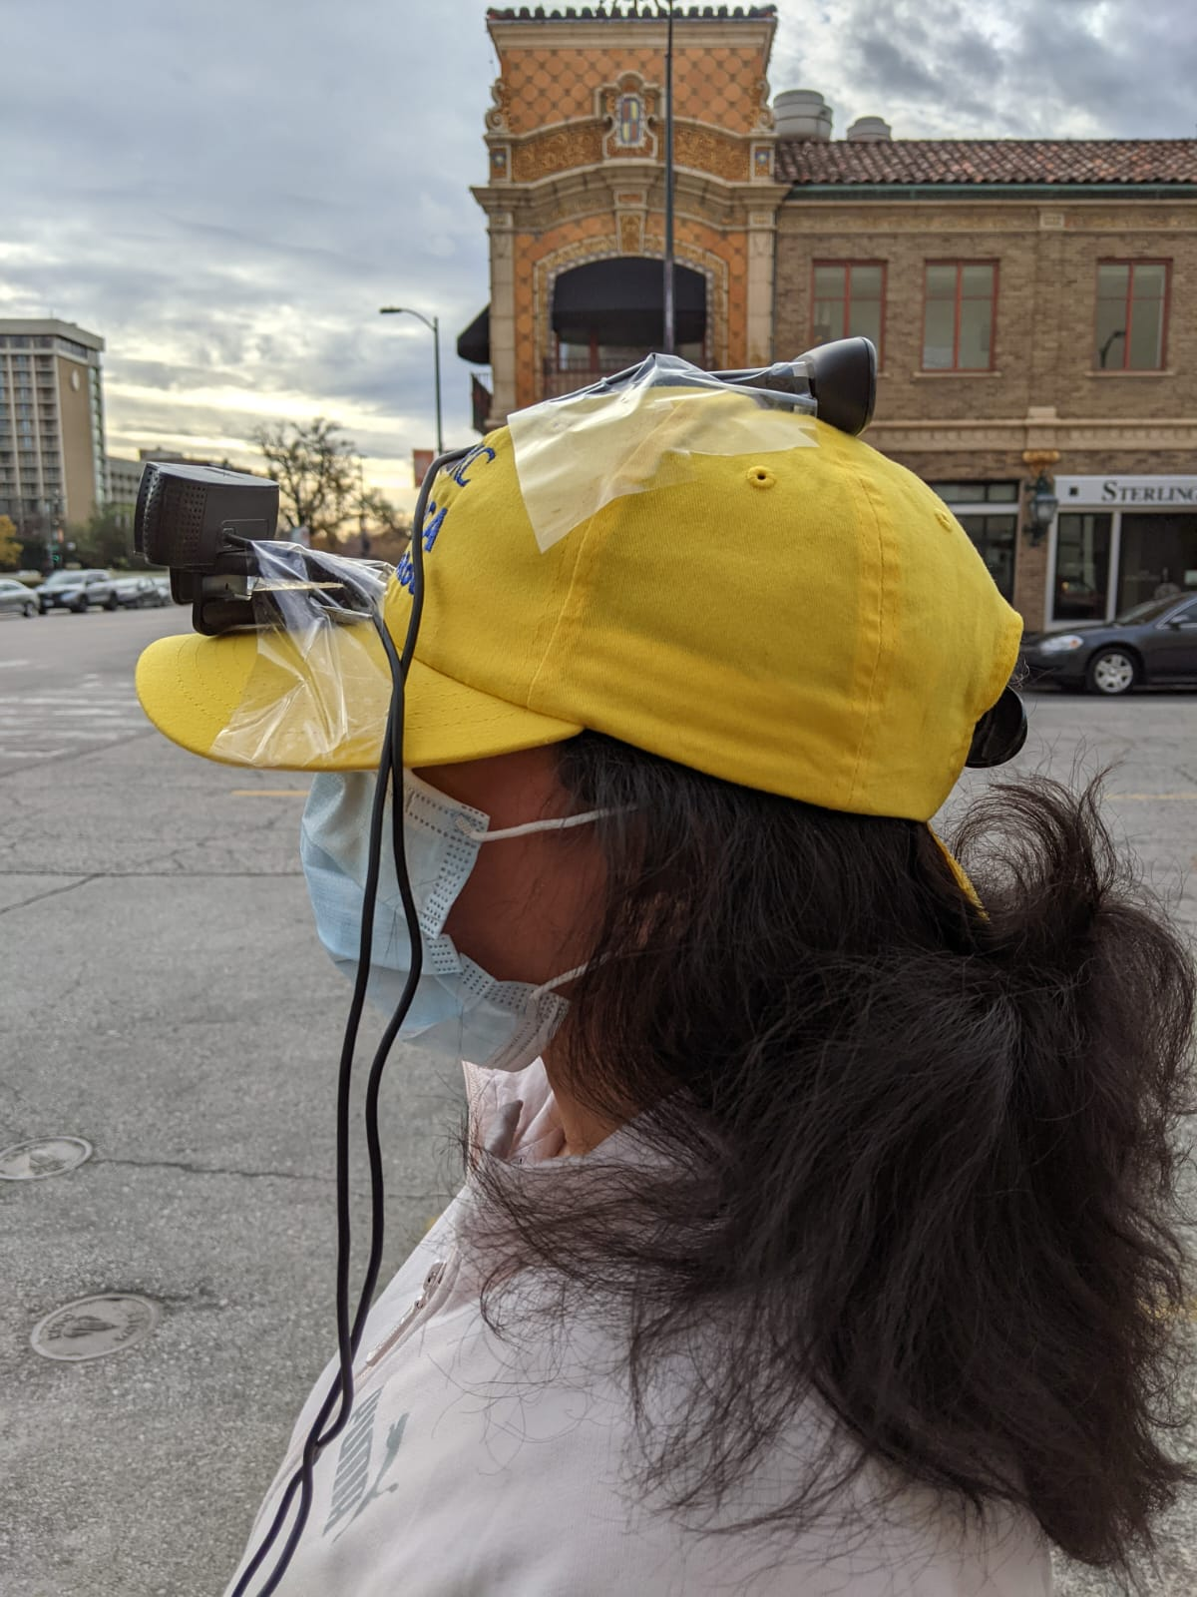
HARDWARE CONSTRUCTION
VYOMA DESAI
We have setup 2 web cameras , one at front and other at back for this project.

Slide 9
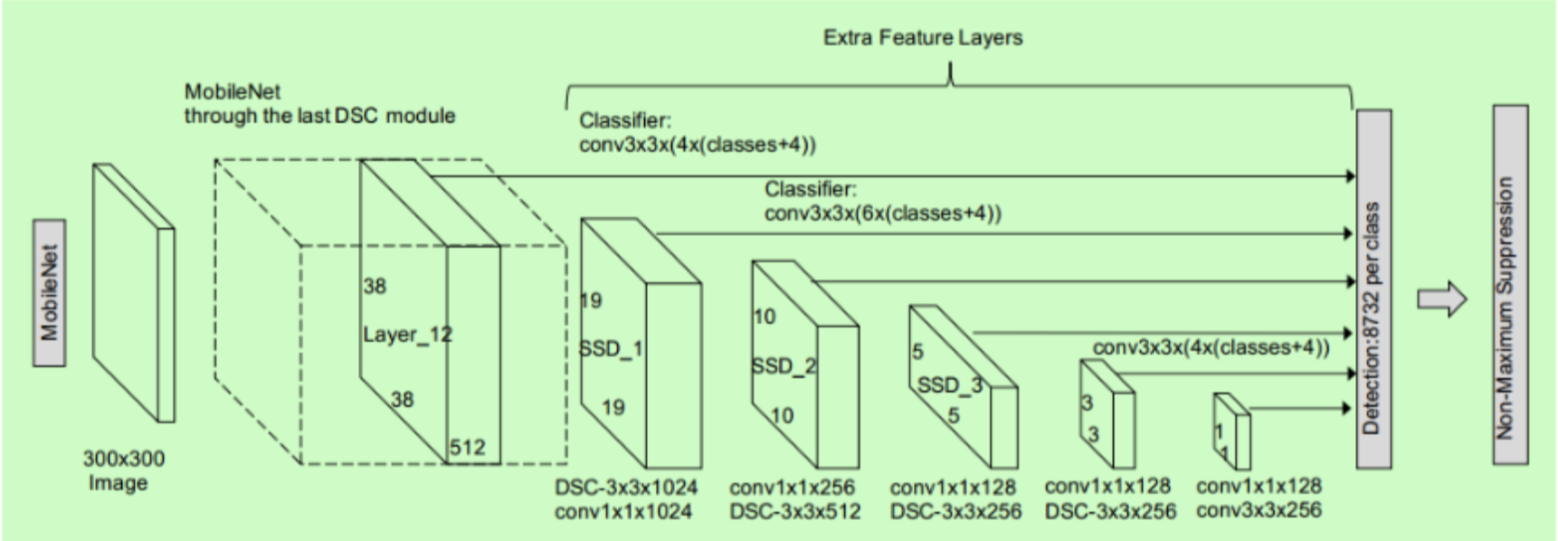
MACHINE LEARNING MODEL
We developed a lightweight face detector using MobileNet SSD (Single Shot Detection) by using Tensorflow object detection API.
This gives us inference time less than 7 milliseconds with an input size of 300 and 300 (image pixel size)
We got an accuracy of around 85%
VYOMA DESAI

Slide 10
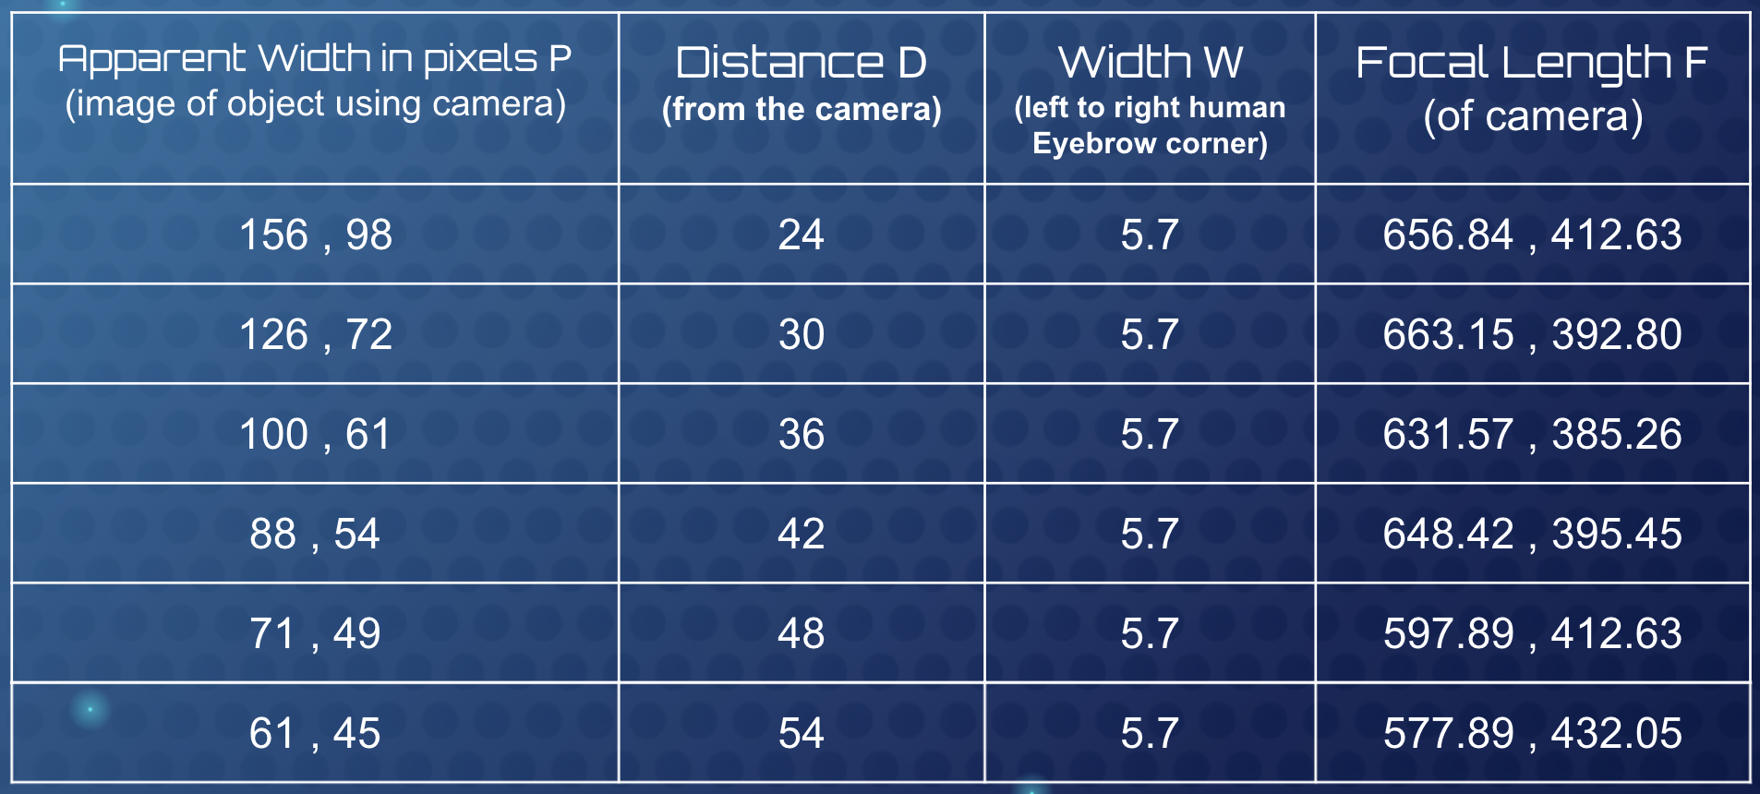
TRIANGLE SIMILARITY (Web-Camera 1 & 2)
This technique helps to find the focal length of the camera
The steps includes
Finding the focal length
Calculate distance of the target
Using Python and OpenCV we find the focal length using : F = ( P * D ) / W
VYOMA DESAI
Average Focal Distance = 680 , 500

Slide 11
DATASET
Mohammed and Divyanshi
One of the challenging subjects in computer vision is object detection, which helps organizations understand and recognise real-time objects with the help of digital pictures as inputs. We choose 32,203 images and label 393,703 faces with high degree of variability, in scale, pose and occlusion as depicted in the sample images.
We have worked on the following :
Research Face Dataset.
There are many available face detection dataset on the web, but after comparing it with many different dataset, we found WIDER FACE DATASET as much appropriate to our project.
Statistics.
WIDER Face dataset is organized based on 61 event classes. For each event class, we have randomly selected 40%/10%/50% data as training, validation and testing sets.
Cleaning and Preprocessing manually to eliminate bad quality, poses, weird angles.

Slide 12
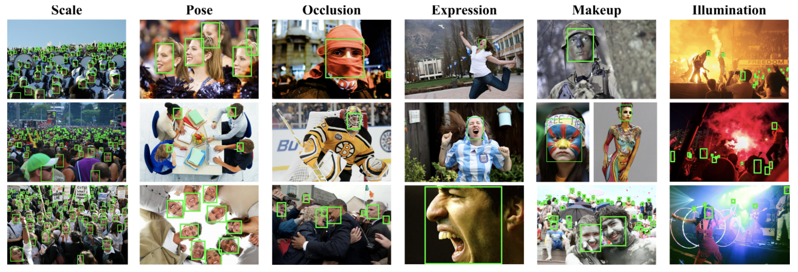
DATASET
Mohammed and Divyanshi
We have used WIDER FACE DATASET :
We choose 32,203 images and label 393,703 faces with high degree of variability, in scale, pose and occlusion as depicted in the sample images.
WIDER Face dataset is organized based on 61 event classes. For each event class, we have randomly selected 40%/10%/50% data as training, validation and testing sets.

Slide 13
Image Scraping & Annotations
TANVI JAIN
We even downloaded approx 1 lakh images from different social media sites and online datasets. We manually labelled these datasets and eliminated bad quality, bad poses as well as weird angles.
We manually rechecked the labels and clarified the bounding box which is required to tighten the forehead, chin, and cheek.
After annotating the face bounding boxes, we further annotate the following attributes: pose (typical, atypical) and occlusion level (partial, heavy).
Each annotation is labeled by one annotator and cross-checked by two different people.
Notes:
Annotation policy. We label the bounding boxes for all
the recognizable faces in the WIDER FACE dataset. The
bounding box is required to tightly contain the forehead,
chin, and cheek, as shown in Fig. 2. If a face is occluded,
we still label it with a bounding box but with an estimation on the scale of occlusion. Similar to the PASCAL
VOC dataset [6], we assign an ’Ignore’ flag to the face
which is very difficult to be recognized due to low resolution and small scale (10 pixels or less). After annotating
the face bounding boxes, we further annotate the following
attributes: pose (typical, atypical) and occlusion level (partial, heavy). Each annotation is labeled by one annotator
and cross-checked by two different people.

Slide 14
TEXT-TO-SPEECH CONVERSION - ALERT SYSTEM
TANVI JAIN
Using gTTS (Google Text to Speech), we have generated an alert system.
Used Parallelization
Alerts are issued after every 5 seconds to avoid nuisance.
Triggered the distance text-to-speech when less than 20 feet.
When in crowded scenes, we have focused on saying 2 or more people to make him/her understand there are many people surrounding either from front or back or from both.
Total number of people approaching from either front or back have also been implemented.

Slide 15
CURRENT FEATURES
TANVI JAIN
Our system supports multiple cameras which provides front and back view, which can help visually challenged person to go with confidence without any fear of collision with any object.
Our MobileNet SSD model inference time is less than 7 milliseconds which is good enough to run on devices such as Raspberry Pi and mobile phones and other low cost hardware.
Additional feature added Text-To-Speech Conversion
Using Triangle Similarity, Distance have been calculated from the camera to other person approaching either from front or at the back.

Slide 16
FUTURE WORK
TANVI JAIN
To detect all kinds of object in addition to the pedestrians
Detect the crosswalk light for safely crossing the road.
Detecting face masks on the pedestrians and issuing an appropriate alert.
Smart navigation can also be added.
Text-to-Speech can be replaced with vibrations system or other system.

Slide 17
REFERENCES
FaceMaskDetection: https://www.kaggle.com/andrewmvd/face-mask-detection
MaskedFace-Net: https://arxiv.org/abs/2008.08016
MobilenetSSD - https://medium.com/@techmayank2000/object-detection-using-ssd-mobilenetv2-using-tensorflow-api-can-detect-any-single-class-from-31a31bbd0691
MobilenetSSD
https://medium.com/axinc-ai/mobilenetssd-a-machine-learning-model-for-fast-object-detection-37352ce6da7d
Object Detection TensorFlow
https://towardsdatascience.com/object-detection-by-tensorflow-2-x-e1199558abc
gTTS
https://towardsdatascience.com/how-to-get-started-with-google-text-to-speech-using-python-485e43d1d544

Slide 18
THANK YOU
Our Github Link :
https://github.com/VyomaD/Hack-A-RooFall-2021
Our Youtube Video Link :
https://www.youtube.com/watch?v=v7FmaY1613U
ANY QUESTIONS?

